Slide 1
GC Internals
How does the .NET Garbage Collector work internally?

Slide 2
Table of Contents
Memory Management: a simplified view
The hard reality
Virtual Memory of .NET processes
The different phases of the .NET GC
How to write GC-friendly code
Got questions? Just ask them!

Slide 3

About Me
Kenny Pflug
Senior Software Developer at Synnotech
PhD student at University of Regensburg
Twitter: @feO2x
GitHub: feO2x
YouTube: youtube.com/c/kennypflug

Slide 4
.NET GC – ‘the heck is this?

Slide 5
Some common opinions about the GC
The GC is part of the Common Language Runtime (CLR) and is used to deallocate memory, so that it can be used for other objects.
It does so by executing a GC Run, consisting of three steps, also called the GC phases: Mark, Sweep, and Compact.
During a run, the GC stops all threads so that it can safely reclaim memory. Therefore, .NET (Core) is not suited for hard real-time apps.
As the GC compacts memory during every run, calling new on a reference type is especially cheap in .NET as the address of the next free part of memory is always known.

Slide 6
A (not so) long time ago in a memory far, far away…
Live Demo

Slide 7
My simple view of the memory
Thread Stack
Managed Heap
String „Joffrey“
ListEntry
String „Cersei“
ObservableCollection<ListEntry>
NamedList
String „Arya‘s List“
ObservableCollection<NamedList>
…
MainWindow ViewModel
MainWindow
…
App

Slide 8
My simple view of the memory
Thread Stack
Managed Heap
String „Joffrey“
ListEntry
String „Cersei“
newListEntry (ListEntry): xxx
ObservableCollection<ListEntry>
Return Address
NamedList
String „Arya‘s List“
entryName (string): ref
ObservableCollection<NamedList>
…
MainWindow ViewModel
MainWindow
…
App

Slide 9
My simple view of the memory
Thread Stack
Managed Heap
String „Joffrey“
ListEntry
String „Cersei“
Activation Frame
newListEntry (ListEntry): xxx
ObservableCollection<ListEntry>
Return Address
NamedList
String „Arya‘s List“
entryName (string): ref
ObservableCollection<NamedList>
…
MainWindow ViewModel
MainWindow
…
App

Slide 10
My simple view of the memory
Thread Stack
Managed Heap
Next Statement:
var newListEntry = new ListEntry(entryName);
String „Joffrey“
ListEntry
String „Cersei“
newListEntry (ListEntry): xxx
ObservableCollection<ListEntry>
Return Address
NamedList
String „Arya‘s List“
entryName (string): ref
ObservableCollection<NamedList>
…
MainWindow ViewModel
MainWindow
…
App

Slide 11
My simple view of the memory
Thread Stack
Managed Heap
Next Statement:
var newListEntry = new ListEntry(entryName);
ListEntry
String „Joffrey“
Return Address
ListEntry
name (string): ref
String „Cersei“
newListEntry (ListEntry): xxx
ObservableCollection<ListEntry>
Return Address
NamedList
String „Arya‘s List“
entryName (string): ref
ObservableCollection<NamedList>
…
MainWindow ViewModel
MainWindow
…
App

Slide 12
My simple view of the memory
Thread Stack
Managed Heap
Next Statement:
Name = name.MustNotBeNullOrWhiteSpace(nameof(name));
ListEntry
String „Joffrey“
Return Address
ListEntry
name (string): ref
String „Cersei“
newListEntry (ListEntry): xxx
ObservableCollection<ListEntry>
Return Address
NamedList
String „Arya‘s List“
entryName (string): ref
ObservableCollection<NamedList>
…
MainWindow ViewModel
MainWindow
…
App

Slide 13
My simple view of the memory
Thread Stack
Managed Heap
Next Statement:
Name = name.MustNotBeNullOrWhiteSpace(nameof(name));
ListEntry
String „Joffrey“
Return Address
ListEntry
name (string): ref
String „Cersei“
newListEntry (ListEntry): xxx
ObservableCollection<ListEntry>
Return Address
NamedList
String „Arya‘s List“
entryName (string): ref
ObservableCollection<NamedList>
…
MainWindow ViewModel
MainWindow
…
App

Slide 14
My simple view of the memory
Thread Stack
Managed Heap
Next Statement:
var newListEntry = new ListEntry(entryName);
ListEntry
String „Joffrey“
Return Address
ListEntry
name (string): ref
String „Cersei“
newListEntry (ListEntry): xxx
ObservableCollection<ListEntry>
Return Address
NamedList
String „Arya‘s List“
entryName (string): ref
ObservableCollection<NamedList>
…
MainWindow ViewModel
MainWindow
…
App

Slide 15
My simple view of the memory
Thread Stack
Managed Heap
Next Statement:
var newListEntry = new ListEntry(entryName);
ListEntry
String „Joffrey“
ListEntry
String „Cersei“
newListEntry (ListEntry): ref
ObservableCollection<ListEntry>
Return Address
NamedList
String „Arya‘s List“
entryName (string): ref
ObservableCollection<NamedList>
…
MainWindow ViewModel
MainWindow
…
App

Slide 16
My simple view of the memory
Thread Stack
Managed Heap
Next Statement:
newListEntry.Priority = SelectedListEntries.Count;
ListEntry
String „Joffrey“
ListEntry
String „Cersei“
newListEntry (ListEntry): ref
ObservableCollection<ListEntry>
Return Address
NamedList
String „Arya‘s List“
entryName (string): ref
ObservableCollection<NamedList>
…
MainWindow ViewModel
MainWindow
…
App

Slide 17
Reference Types vs. Value Types
Reference Types:
Class
Interface
Delegate
Instances always in the Managed Heap
Call by reference
Value Types:
Struct
Enum
Instances are placed directly in variables, parameters, or object fields.
Call by value

Slide 18
My simple view of the memory
Thread Stack
Managed Heap
Next Statement:
newListEntry.Priority = SelectedListEntries.Count;
ListEntry
String „Joffrey“
ListEntry
String „Cersei“
newListEntry (ListEntry): ref
ObservableCollection<ListEntry>
Return Address
NamedList
String „Arya‘s List“
entryName (string): ref
ObservableCollection<NamedList>
…
MainWindow ViewModel
MainWindow
…
App

Slide 19
My simple view of the memory
Thread Stack
Managed Heap
Next Statement:
newListEntry.Priority = SelectedListEntries.Count;
ListEntry
Name (string): ref
Priority (int): 0
String „Joffrey“
ListEntry
String „Cersei“
newListEntry (ListEntry): ref
ObservableCollection<ListEntry>
Return Address
NamedList
String „Arya‘s List“
entryName (string): ref
ObservableCollection<NamedList>
…
MainWindow ViewModel
MainWindow
…
App

Slide 20
My simple view of the memory
Thread Stack
Managed Heap
Next Statement:
newListEntry.Priority = SelectedListEntries.Count;
ListEntry
Name (string): ref
Priority (int): 1
String „Joffrey“
ListEntry
String „Cersei“
newListEntry (ListEntry): ref
ObservableCollection<ListEntry>
Return Address
NamedList
String „Arya‘s List“
entryName (string): ref
ObservableCollection<NamedList>
…
MainWindow ViewModel
MainWindow
…
App

Slide 21
My simple view of the memory
Thread Stack
Managed Heap
Next Statement:
SelectedListEntries.Add(newListEntry);
ListEntry
Name (string): ref
Priority (int): 1
String „Joffrey“
ListEntry
String „Cersei“
newListEntry (ListEntry): ref
ObservableCollection<ListEntry>
Return Address
NamedList
String „Arya‘s List“
entryName (string): ref
ObservableCollection<NamedList>
…
MainWindow ViewModel
MainWindow
…
App

Slide 22
My simple view of the memory
Thread Stack
Managed Heap
Next Statement:
SelectedListEntries.Add(newListEntry);
ListEntry
Name (string): ref
Priority (int): 1
String „Joffrey“
ListEntry
String „Cersei“
newListEntry (ListEntry): ref
ObservableCollection<ListEntry>
Return Address
NamedList
String „Arya‘s List“
entryName (string): ref
ObservableCollection<NamedList>
…
MainWindow ViewModel
MainWindow
…
App

Slide 23
My simple view of the memory
Thread Stack
Managed Heap
ListEntry
Name (string): ref
Priority (int): 1
String „Joffrey“
ListEntry
String „Cersei“
ObservableCollection<ListEntry>
NamedList
String „Arya‘s List“
ObservableCollection<NamedList>
…
MainWindow ViewModel
MainWindow
…
App

Slide 24
Let’s cross someone off the list
Live Demo

Slide 25
My simple view of the memory
Thread Stack
Managed Heap
ListEntry
Name (string): ref
Priority (int): 1
String „Joffrey“
ListEntry
String „Cersei“
ObservableCollection<ListEntry>
NamedList
String „Arya‘s List“
ObservableCollection<NamedList>
…
MainWindow ViewModel
MainWindow
…
App

Slide 26
My simple view of the memory
Thread Stack
Managed Heap
Next Statement:
SelectedListEntries.Remove(SelectedListEntry);
ListEntry
Name (string): ref
Priority (int): 1
String „Joffrey“
ListEntry
String „Cersei“
ObservableCollection<ListEntry>
NamedList
String „Arya‘s List“
Return Address
ObservableCollection<NamedList>
…
MainWindow ViewModel
MainWindow
…
App

Slide 27
My simple view of the memory
Thread Stack
Managed Heap
Next Statement:
SelectedListEntries.Remove(SelectedListEntry);
ListEntry
Name (string): ref
Priority (int): 1
String „Joffrey“
ListEntry
String „Cersei“
ObservableCollection<ListEntry>
NamedList
String „Arya‘s List“
Return Address
ObservableCollection<NamedList>
…
MainWindow ViewModel
MainWindow
…
App

Slide 28
My simple view of the memory
Thread Stack
Managed Heap
ListEntry
Name (string): ref
Priority (int): 1
String „Joffrey“
ListEntry
String „Cersei“
ObservableCollection<ListEntry>
NamedList
String „Arya‘s List“
ObservableCollection<NamedList>
…
MainWindow ViewModel
MainWindow
…
App

Slide 29
The Garbage Collector in Action
Live Demo

Slide 30
My simple view of the memory
Thread Stack
Managed Heap
Garbage Collector
1. Mark Phase
ListEntry
Name (string): ref
Priority (int): 1
String „Joffrey“
ListEntry
String „Cersei“
ObservableCollection<ListEntry>
NamedList
String „Arya‘s List“
…
ObservableCollection<NamedList>
Main
MainWindow ViewModel
MainWindow
…
App

Slide 31
GC Roots
Variables and parameters
Static fields
Objects with Finalizers
Pinned Objects

Slide 32
Listeneintrag entfernen und GC Run
Thread Stack
Managed Heap
Garbage Collector
1. Mark Phase
ListEntry
Name (string): ref
Priority (int): 1
String „Joffrey“
ListEntry
String „Cersei“
ObservableCollection<ListEntry>
NamedList
String „Arya‘s List“
…
ObservableCollection<NamedList>
Main
MainWindow ViewModel
MainWindow
…
App

Slide 33
Listeneintrag entfernen und GC Run
Thread Stack
Managed Heap
Garbage Collector
1. Mark Phase
ListEntry
Name (string): ref
Priority (int): 1
String „Joffrey“
ListEntry
String „Cersei“
ObservableCollection<ListEntry>
NamedList
String „Arya‘s List“
…
ObservableCollection<NamedList>
Main
MainWindow ViewModel
MainWindow
…
App

Slide 34
Listeneintrag entfernen und GC Run
Thread Stack
Managed Heap
Garbage Collector
Mark Phase
Sweep Phase
ListEntry
Name (string): ref
Priority (int): 1
String „Joffrey“
ListEntry
String „Cersei“
ObservableCollection<ListEntry>
NamedList
String „Arya‘s List“
…
ObservableCollection<NamedList>
Main
MainWindow ViewModel
MainWindow
…
App

Slide 35
Listeneintrag entfernen und GC Run
Thread Stack
Managed Heap
Garbage Collector
Mark Phase
Sweep Phase
ListEntry
Name (string): ref
Priority (int): 1
String „Joffrey“
ObservableCollection<ListEntry>
NamedList
String „Arya‘s List“
…
ObservableCollection<NamedList>
Main
MainWindow ViewModel
MainWindow
…
App

Slide 36
Listeneintrag entfernen und GC Run
Thread Stack
Managed Heap
Garbage Collector
Mark Phase
Sweep Phase
Compact Phase
ListEntry
Name (string): ref
Priority (int): 1
String „Joffrey“
ObservableCollection<ListEntry>
NamedList
String „Arya‘s List“
…
ObservableCollection<NamedList>
Main
MainWindow ViewModel
MainWindow
…
App

Slide 37
Listeneintrag entfernen und GC Run
Thread Stack
Managed Heap
Garbage Collector
Mark Phase
Sweep Phase
Compact Phase
Memory for next object
ListEntry
Name (string): ref
Priority (int): 1
String „Joffrey“
ObservableCollection<ListEntry>
NamedList
String „Arya‘s List“
…
ObservableCollection<NamedList>
Main
MainWindow ViewModel
MainWindow
…
App

Slide 38
Oh my, the harsh reality

Slide 39
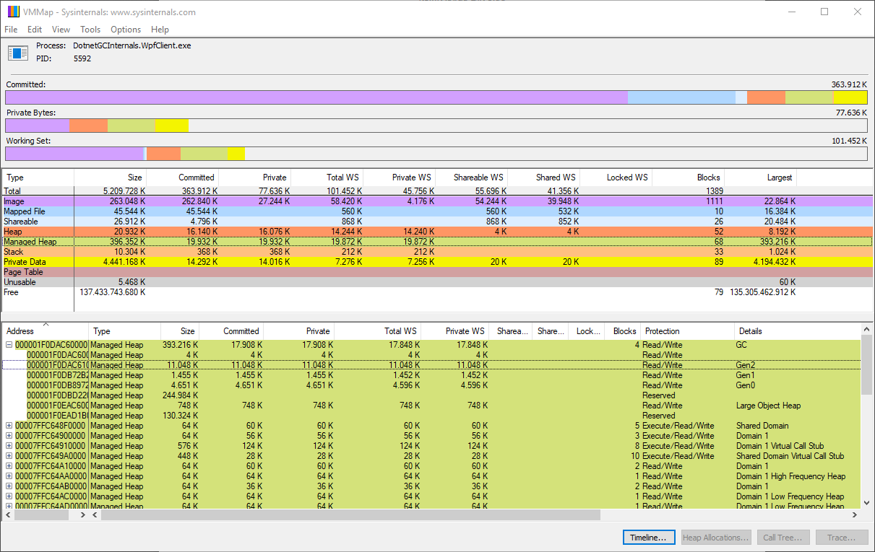
VMMap – Virtual Memory of .NET Processes

Slide 40
Vereinfachte Sicht auf x64 Process Virtual Memory in Windows
Kernel Data / Binaries
Thread Stack n
Images / DLLs
VirtualAlloc grow
Managed Heap
Native Heap
Thread Stack 2…
Thread Stack 1

Slide 41
The GC Heap

Slide 42
Small Object Heap or Large Object Heap?
Small Object Heap
85.000 Bytes?
Large Object Heap
greater than or equal to
smaller

Slide 43
Small Object Heap (SOH) vs. Large Object Heap (LOH)
SOH:
Split into three generations
Can be compacted
All kinds of objects (less than 85.000B)
Fast allocation possible
LOH:
One large memory region
Will not be compacted by default
Contains mostly large arrays
No fast allocation possible

Slide 44
Talkin’ ‘bout my generation…
Generations in the Small Object Heap

Slide 45
SOH: Generations

Slide 46
SOH: Generations
A
B
C

Slide 47
SOH: Generations
A
B
C

Slide 48
SOH: Generations
A
C

Slide 49
SOH: Generations
Generation 1
Generation 0
A
C

Slide 50
SOH: Generations
Generation 1
Generation 0
A
C
D
E
F

Slide 51
SOH: Generations
Generation 1
Generation 0
A
C
D
E
F

Slide 52
SOH: Generations
Generation 2
Generation 1
Generation 0
A
F

Slide 53
SOH: Generations
Generation 2
Generation 1
Generation 0
A
F
G
H
I
J

Slide 54
SOH: Generations
Generation 2
Generation 1
Generation 0
A
F
G
H
I
J

Slide 55
SOH: Generations
Generation 2
Generation 1
Generation 0
A
F
G
I
J

Slide 56
SOH: Generations
Generation 2
Generation 1
Generation 0
A
F
G
I
J
K
L
M
N

Slide 57
SOH: Generations
Generation 2
Generation 1
Generation 0
A
F
G
I
J
K
L
M
N

Slide 58
SOH: Generations
Generation 2
Generation 1
Generation 0
A
F
G
I
J
K
M

Slide 59
SOH: Generations
Generation 2
Generation 1
Generation 0
A
F
G
I
J
K
M

Slide 60
Segments

Slide 61
Segments for structuring parts of the memory
Small Object Heap
Large Object Heap
Segment 1
Segment 2
Segment 3
Segment 4
Segment 5

Slide 62
Segments for structuring parts of the memory
Small Object Heap
Large Object Heap
Segment 1
Segment 2
Segment 3
Segment 4
Segment 5
Only the last segment contains Gen 0 and 1 Ephemeral Segment

Slide 63
Segments for structuring parts of the memory
Segments must not be in continuous parts of the virtual memory.
Small Object Heap
Large Object Heap
Segment 1
Segment 2
Segment 3
Segment 4
Segment 5

Slide 64
Memory Allocation and Allocation Contexts

Slide 65
Allocating in SOH and LOH
SOH:
Try to allocate in the next free part of the allocation context.
If not possible, then try to move the allocation context within G0 to a free position and try to allocate there.
If not possible, then try to commit more memory in the epheremal segment.
If not possible, then perform a GC Run and, if needed, create a new Ephemeral Segment.
If not possible -> OutOfMemoryException
Point 1 is not possible if your class has a Finalizer.
LOH:
Try to find empty space.
If not possible, try to commit more memory.
If not possible, perform a Full GC Run (ptoentially several times).
If not possible -> OutOfMemoryException

Slide 66
Allocation Contexts
Reserved Memory
Committed Memory
Segment Info
zeroed
zeroed
zeroed
Allocation Context 1
Allocation Context 2
Allocation Context 3

Slide 67
Allocation Contexts
Free List
Reserved Memory
Committed Memory
Segment Info
zeroed
zeroed
zeroed
Allocation Context 1
Allocation Context 2
Allocation Context 3

Slide 68
Allocation Contexts (after GC Compact Phase)
Reserved Memory
Committed Memory
Segment Info
zeroed
zeroed
zeroed
Allocation Context 1
Allocation Context 2
Allocation Context 3

Slide 69
Garbage Collector Runs

Slide 70
Two Modes: Foreground GC and Background GC
Foreground GC:
Stops all Managed Threads over the total time of the GC run
Can compact memory
Generations are only moved when memory is compacted.
Background GC:
Runs on a dedicated GC Thread, Managed Threads are only stopped shortly
Cannot compact memory

Slide 71
Foreground GC
A thread signals need for more memory (during memory allocation)
The GC stops all Managed Threads
The target generation is condemned
Mark: using GC Roots, the GC traverses the reachable objects in the Managed Heap
Plan: the GC executes a virtual compact phase and decides whether a Sweep or Compact will be executed.
Sweep with or without Compact: the GC deallocates non-reachable objects, available memory is either added to the Free List or compacted. In case of the latter, the generational boundaries are moved.
The Managed Threads are signaled to continue execution.

Slide 72
Concurrent Background GC
A thread signals need for more memory (during memory allocation)
The GC shortly stops all Managed Threads to prepare internal data structures
Concurrent Mark: the GC traverses the Managed Heap while the Managed Thread continue execution.
After the Concurrent Mark phase, the GC stops all Managed Threads shortly to traverse modified memory regions again (The Lost Object Problem)
Concurrent Sweep: the GC deallocates non-reachable objects while the other threads continue execution, deallocated memory is added to the Free List

Slide 73
The GC Plan phase

Slide 74
GC Plan Phase
A
B
C
D
E
F
G
H
I
J

Slide 75
GC Plan Phase
B
D
E
F
I
J
A
B
C
E
F
G
H
I
J

Slide 76
GC Plan Phase
B
D
E
F
I
J
A
B
C
E
F
G
H
I
J

Slide 77
GC Plan Phase
D
E
F
I
J
A
B
C
E
F
G
H
I
J
B

Slide 78
GC Plan Phase
D
E
F
G
H
I
J
A
B
C
I
J
B
E
F

Slide 79
GC Plan Phase
D
E
F
G
H
A
B
C
H
I
J
B
E
F
I
J

Slide 80
GC Plan Phase
A
B
C
D
E
F
G
H
I
J
B
E
F
I
J
H

Slide 81
GC Plan Phase
A
B
C
D
E
F
G
H
I
J
B
E
F
I
J
H

Slide 82
Some advice for GC-friendly code

Slide 83
Objects with Finalizers
Allocating objects with finalizers is always slow, because these objects need to be tracked in an GC internal data structure.
When marked for sweep, they will not be deallocated, but put in the fReachableQueue.
The Finalizer will be executed on the dedicated GC Finalizer Thread.
Thus objects with Finalizer always reach Gen 1.
Finalizers can contain arbitrary code like assigning ‘this’ to a static variable -> Resurrection
Just avoid Finalizers. Implement and use IDisposable properly.

Slide 84
Avoid Allocations in Performance-Critical Code
Use Value Types (structs, enums) for Encapsulation
Avoid Boxing -> maybe ref structs are an option, they can only exist on a Thread Stack
Be aware of hidden allocations:
Reflection-based algorithms (WPF Data Binding, ORM, DI Container, Serializers)
Delegates / Events
Anonymous Methods that use Closure (Lexical Scoping)
String Concatenations
Incorporate Span<T> and Memory<T>
If you do not allocate, the GC won’t start a run.

Slide 85
Hidden Allocations
Live Demo

Slide 86
Performance JSON Serializer
Live Demo

Slide 87
Measure Memory Utilization
VMMap
PerfView
BenchmarkDotNet
JetBrains DotMemory
Windows Performance Analyzer
…and many other tools

Slide 88
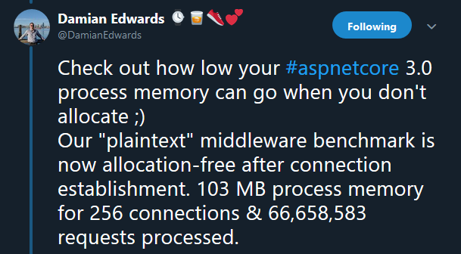
Era of Performance

Slide 89
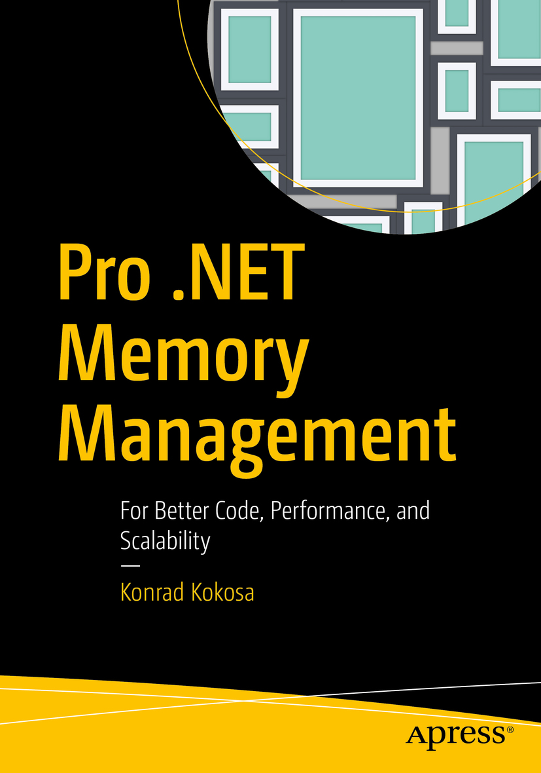
Pro .NET Memory Management

Slide 90
Additional Literature
Book of the Runtime: https://github.com/cwoodruff/The-Book-of-the-Runtime
Ben Watson: Writing High-Performance .NET Code
Sasha Goldshtein, Dima Zurbal: Pro .NET Performance, Apress
Source Code Core CLR: https://github.com/dotnet/coreclr GC Source Code: https://raw.githubusercontent.com/dotnet/coreclr/master/src/gc/gc.cpp

Slide 91
Thank you!
Slides and code are available at https://github.com/feO2x/DNDGGraz.GCInternals

